Slide 1
Greedy Algorithms
Greedy is an algorithmic paradigm that builds up a solution piece by piece, always choosing the next piece that offers the most obvious and immediate benefit.
Greedy algorithms are used for optimization problems.
An optimization problem can be solved using Greedy if the problem has the following property:
At every step, we can make a choice that looks best at the moment, and we get the optimal solution of the complete problem.
If a Greedy Algorithm can solve a problem, then it generally becomes the best method to solve that problem as the Greedy algorithms are in general more efficient than other techniques like Dynamic Programming.

Slide 2
But Greedy algorithms cannot always be applied. For example, Fractional Knapsack problem can be solved using Greedy, but 0-1 Knapsack cannot be solved using Greedy.
Following are some standard algorithms that are Greedy algorithms.
1) Kruskal’s Minimum Spanning Tree (MST): In Kruskal’s algorithm, we create a MST by picking edges one by one. The Greedy Choice is to pick the smallest weight edge that doesn’t cause a cycle in the MST constructed so far. 2) Prim’s Minimum Spanning Tree: In Prim’s algorithm also, we create a MST by picking edges one by one.
We maintain two sets: set of the vertices already included in MST and the set of the vertices not yet included.
The Greedy Choice is to pick the smallest weight edge that connects the two sets.

Slide 3
3) Dijkstra’s Shortest Path: The Dijkstra’s algorithm is very similar to Prim’s algorithm.
The shortest path tree is built up, edge by edge.
We maintain two sets: set of the vertices already included in the tree and the set of the vertices not yet included.
The Greedy Choice is to pick the edge that connects the two sets and is on the smallest weight path from source to the set that contains not yet included vertices. 4) Huffman Coding: Huffman Coding is a loss-less compression technique.
It assigns variable length bit codes to different characters.
The Greedy Choice is to assign least bit length code to the most frequent character.

Slide 4
The greedy algorithms are sometimes also used to get an approximation for Hard optimization problems.
For example, Traveling Salesman Problem is a NP (Nondeterministic Polynomial time) Hard problem.
A Greedy choice for this problem is to pick the nearest unvisited city from the current city at every step.
This solutions doesn’t always produce the best optimal solution, but can be used to get an approximate optimal solution.

Slide 5
Greedy Algorithms (Kruskal’s Minimum Spanning Tree Algorithm)
Minimum Spanning Tree:
Given a connected and undirected graph, a spanning tree of that graph is a subgraph that is a tree and connects all the vertices together.
A single graph can have many different spanning trees.
A minimum spanning tree (MST) or minimum weight spanning tree for a weighted, connected and undirected graph is a spanning tree with weight less than or equal to the weight of every other spanning tree.

Slide 6
The weight of a spanning tree is the sum of weights given to each edge of the spanning tree.
How many edges does a minimum spanning tree has?
A minimum spanning tree has (V – 1) edges where V is the number of vertices in the given graph.
Applications of Minimum Spanning Tree:
Below are the steps for finding MST using Kruskal’s algorithm
1. Sort all the edges in non-decreasing order of their weight. 2. Pick the smallest edge. Check if it forms a cycle with the spanning tree formed so far. If cycle is not formed, include this edge. Else, discard it. 3. Repeat step#2 until there are (V-1) edges in the spanning tree.

Slide 7
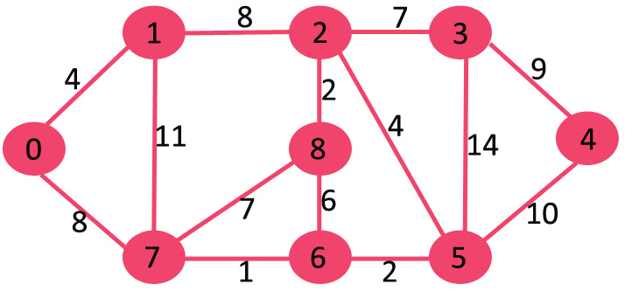
Example:

Slide 8
The algorithm is a Greedy Algorithm.
The Greedy Choice is to pick the smallest weight edge that does not cause a cycle in the MST constructed so far.
The graph contains 9 vertices and 14 edges. So, the minimum spanning tree formed will be having (9 – 1) = 8 edges.

Slide 9
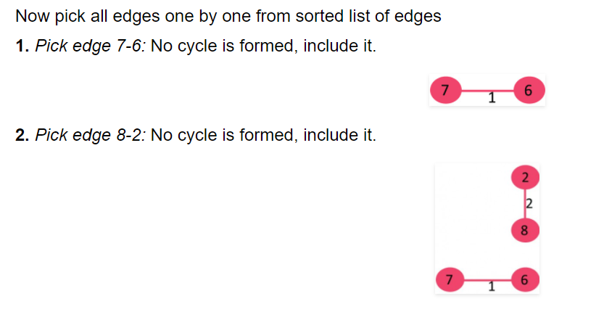

Slide 10
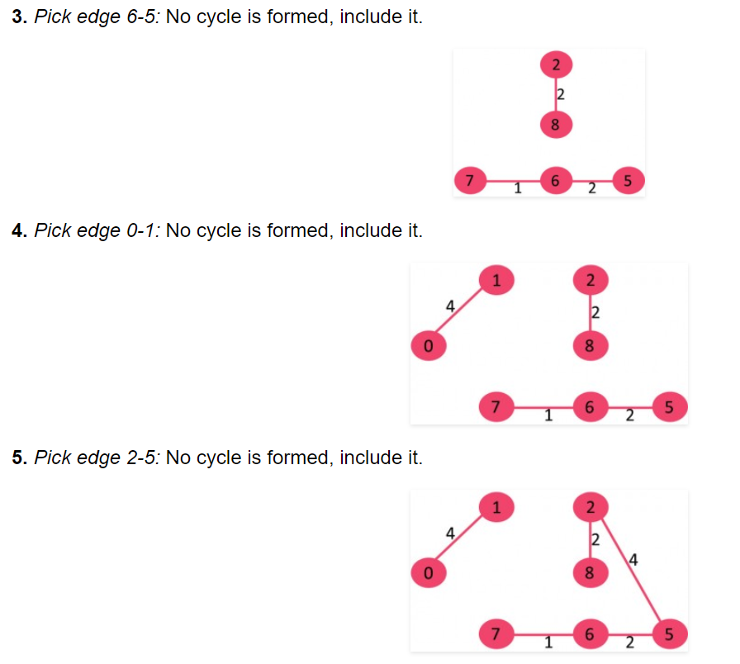

Slide 11
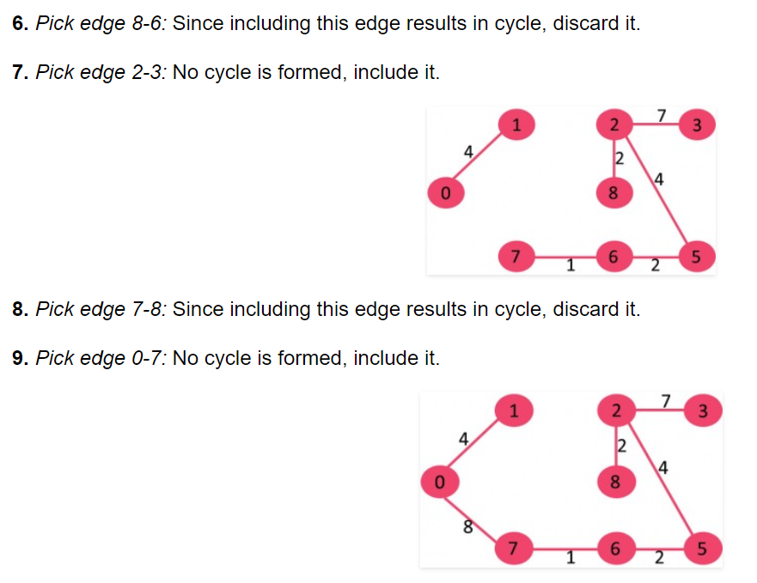

Slide 12
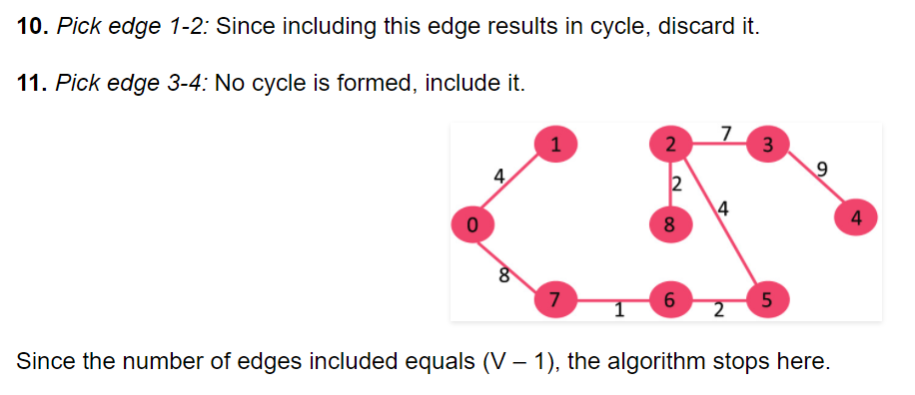

Slide 13
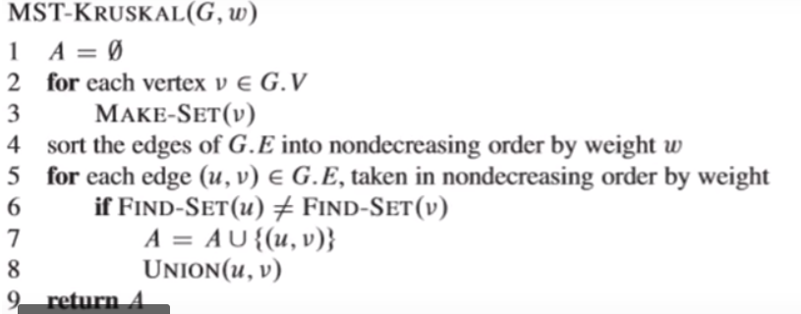

Slide 14
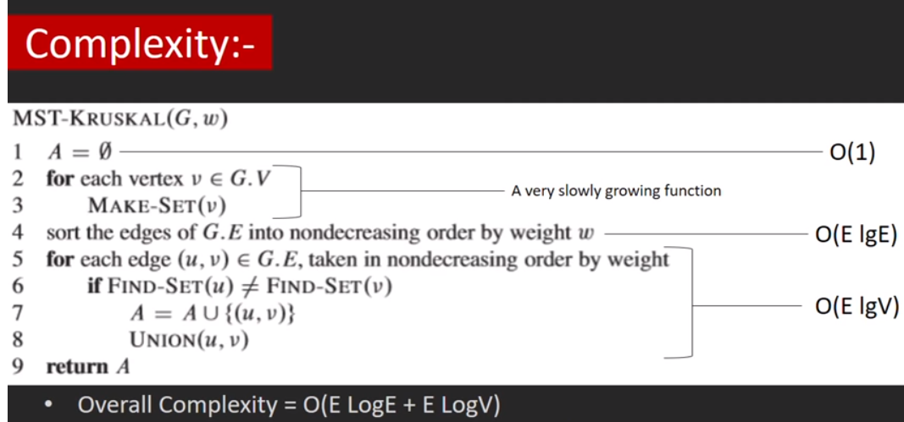

Slide 15
Greedy Algorithms (Dijkstra’s shortest path algorithm)
Given a graph and a source vertex in graph, find shortest paths from source to all vertices in the given graph.
Below are the detailed steps used in Dijkstra’s algorithm to find the shortest path from a single source vertex to all other vertices in the given graph.
Algorithm:
1) Create a set sptSet (shortest path tree set) that keeps track of vertices included in shortest path tree, i.e., whose minimum distance from source is calculated and finalized. Initially, this set is empty.

Slide 16
2) Assign a distance value to all vertices in the input graph. Initialize all distance values as INFINITE. Assign distance value as 0 for the source vertex so that it is picked first.
3) While sptSet doesn’t include all vertices ….a) Pick a vertex u which is not there in sptSet and has minimum distance value. ….b) Include u to sptSet. ….c) Update distance value of all adjacent vertices of u.
To update the distance values, iterate through all adjacent vertices.
For every adjacent vertex v, if sum of distance value of u (from source) and weight of edge u-v, is less than the distance value of v, then update the distance value of v.

Slide 17
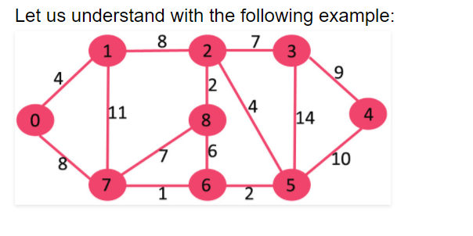

Slide 18
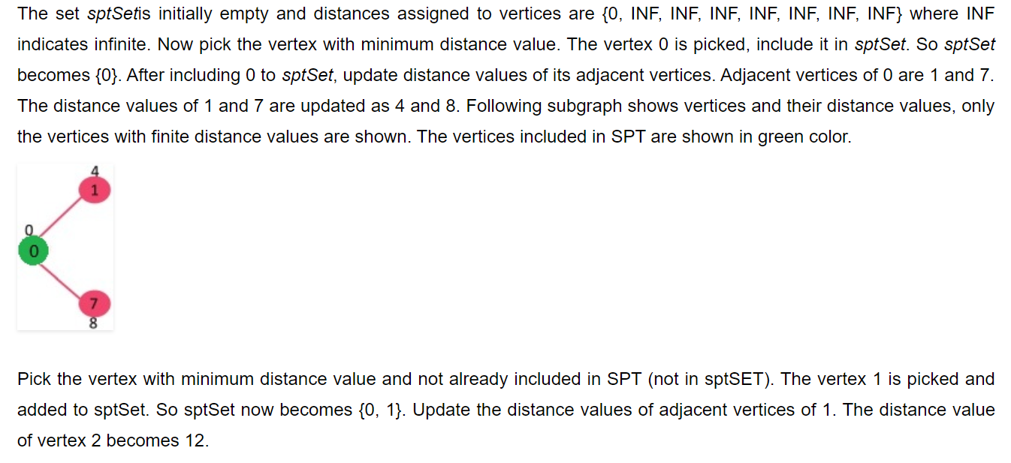
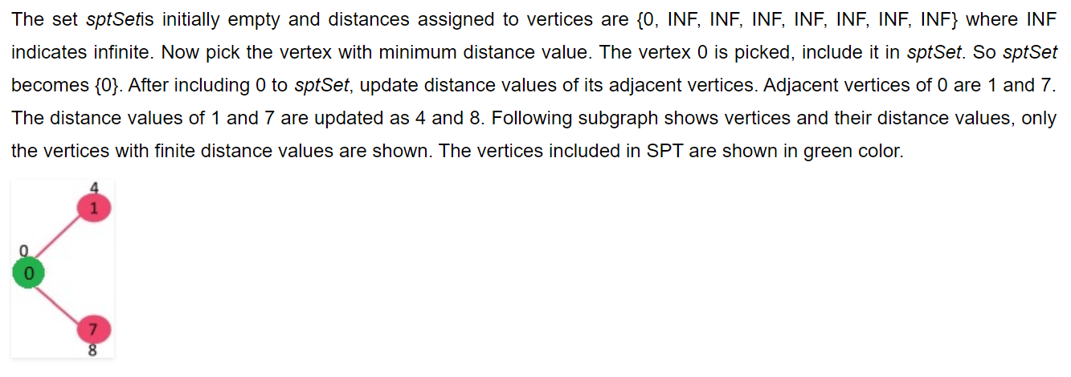

Slide 19
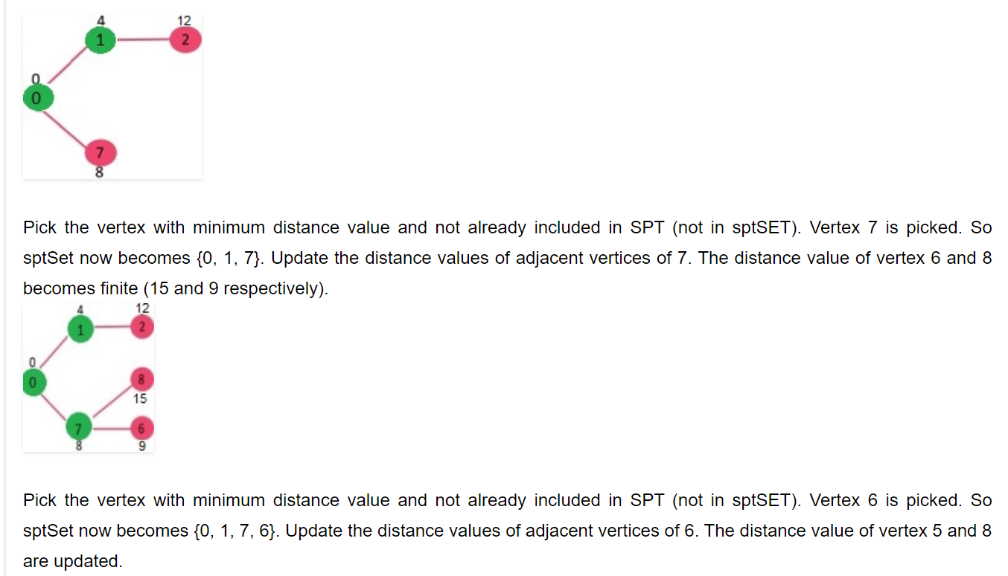

Slide 20
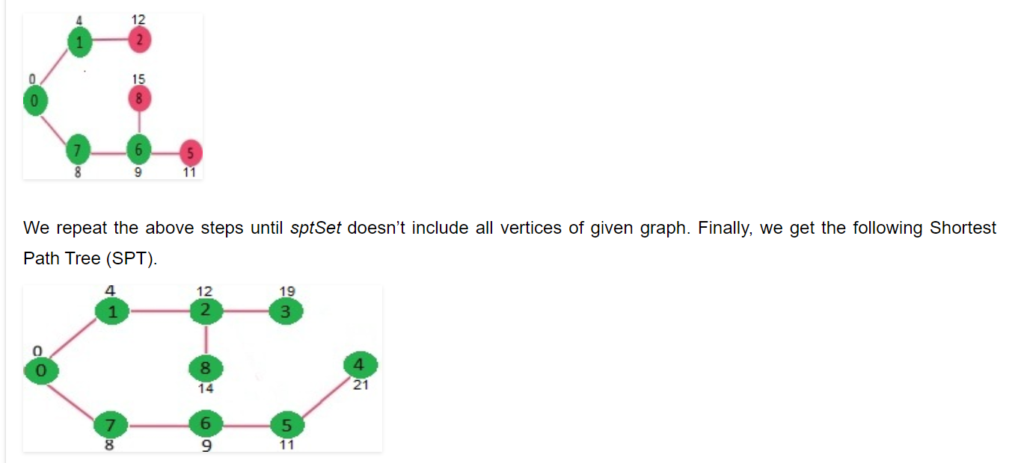

Slide 21
Dijkstra’s algorithm doesn’t work for graphs with negative weight edges.
For graphs with negative weight edges, Bellman–Ford algorithm can be used.

